Slide 1
Notes:
The Restoration Movement began early in the 19th century when certain members from different denominations (Methodists, Baptists, Presbyterians) began to realize that they had gotten away from NT Christianity. They therefore left their denominational groups in order to establish a church patterned after that which is taught in the NT. Their goal was to re-establish Christ's church as He Himself created it through the apostles’ doctrine beginning on the day of Pentecost in Acts 2 and they desired to use the bible as their only standard and pattern for doctrine. Since denominationalism had gotten so out of hand and churches were developing practices that were not biblical, their mission was also to encourage others to stand against the division created by denominationalism and to aspire for the purity and simplicity of NT Christianity, to abandon their dividing religions and become united under one church with Christ as head and the NT as her authority.
There were many individuals who took this stand, but two men in particular led the charge early on – Barton Stone and Alexander Campbell.

Slide 2
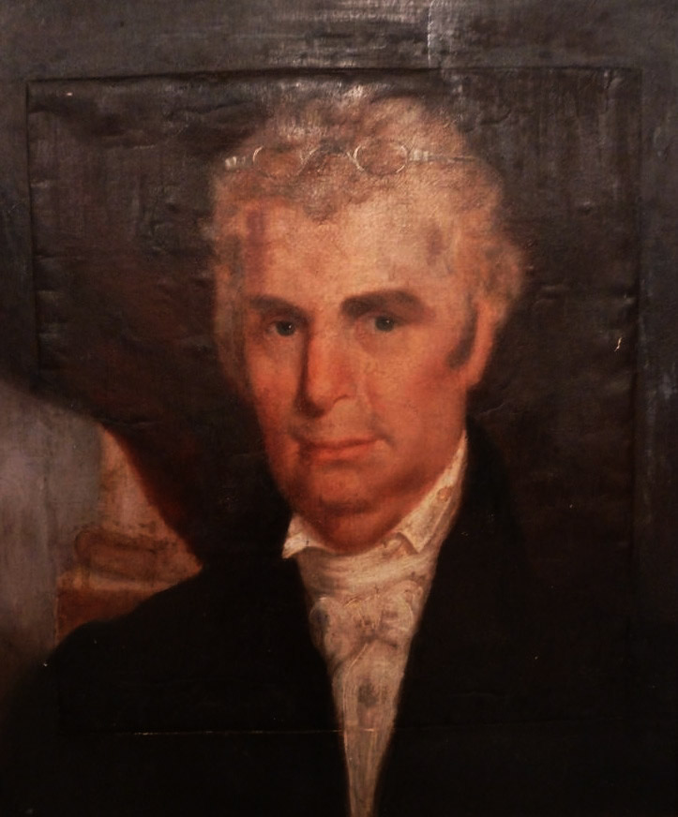
Barton Stone
Former Presbyterian Minister
Began to see differences between Calvin’s tenants (TULIP) and the bible
In 1804, Stone and five other ministers officially withdrew from the Presbyterian church
Goal was to abolish creeds and return to the principles of the NT
Only wanted to be identified as “Christians”; therefore their group was first called the “Christian Church”
Other independent groups begun by Elias Smith and James O’Kelly eventually found out about one another and declared themselves as “one”
Notes:
History tells us that very early on in Barton Stone’s life, he was not very religious because he found the competing claims of denominational churches like Episcopalians, Baptists, and Methodists to be confusing as many of their doctrines were diametrically opposed to the other. This was a stumbling to Stone that is not unfamiliar in our society as many agnostics and atheists view division within the realm of Christianity as a reason for their skepticism. However while in college, Stone heard an evangelical Presbyterian minister named James McGready speak and was moved to become a minister. He was later ordained as a Presbyterian minister.
Later on as Stone began comparing Calvinistic teaching he had learned from the Presbyterian church with the bible, he began to reject the doctrines of Total Hereditary Depravity and Unconditional Election. The division within the Presbyterian church itself gave him no comfort as well, as there were around 20 different sects of Presbyterians that existed at the time. When Stone disagreed with the Presbyterian church’s censuring of a minister who started teaching things that deviated from their creed (the Westminster Confession of Faith), Stone and 5 other ministers withdrew and formed a new group called the “Springfield Presbytery”. However, as it began to grow, attracting churches from KY and OH, they saw the sectarian nature of what they had done and therefore abolished it.
The goal of these former denominational minsters was to abolish all creeds because they saw them as unnecessary and a stumbling block to using the bible alone. They wanted no affiliation with manmade organizations who would dictate the direction they needed to take religiously. Rather, their desire was to return to using the bible as the only standard of Christians faith and practice. Only wanting to be identified as Christians, therefore, the remnants of the Springfield Presbytery became known as the “Christian Church”.
There were other lesser-known men who were striving for the same separation from denominationalism such as Elias Smith and James O’Kelly and they eventually heard what Stone was trying to do. They found one another and began identifying as one group. One of the encouraging things about this movement is how many people were seeking the same goal of restoration who at one point didn’t know the others existed. Their stands were completely independent from one another in the early going.

Slide 3
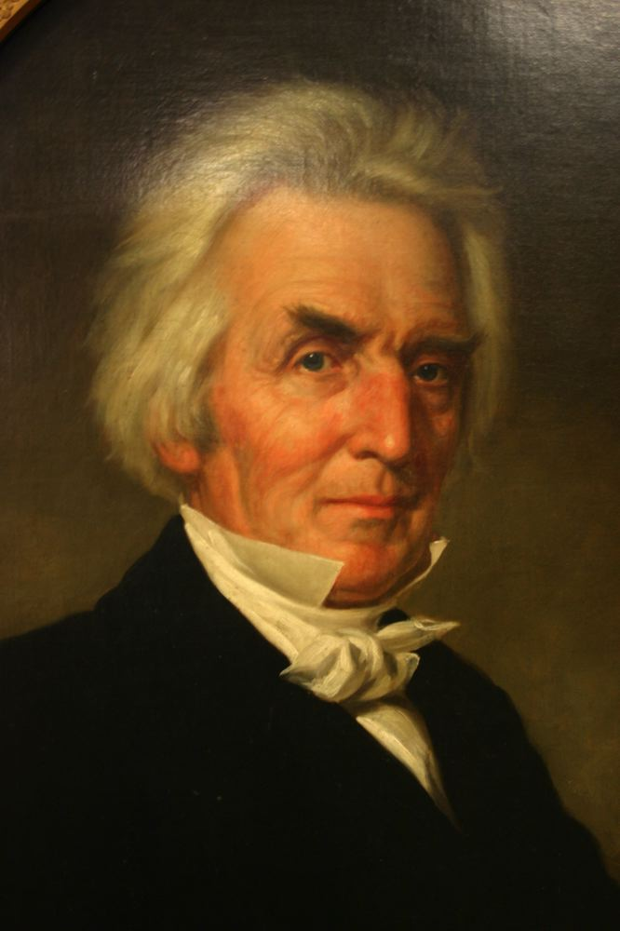
Alexander Campbell
Baptist Minister
Alexander and his father Thomas were influenced early on by James & Robert Haldane while in Scotland
Established the Brush Run Church in Pennsylvania, though kept it aligned with the Baptist Association
Disagreement over “essential” and “non-essential” elements of the NT led to a break with the Baptists
Thomas heard Walter Scott preaching similar tenants and welcomed him as a contributor
“Disciples of Christ”
Notes:
Alexander Campbell and his father Thomas were of Scottish/Irish descent and would eventually emigrated to America. However, they were both greatly influenced in Scotland by James and Robert Haldane who had planted 85 churches there and practiced baptism by immersion, weekly partaking of the Lord’s Supper, and church autonomy. Once they emigrated to American, they brought this mindset with them that would become a stepping stone to greater things.
Thomas had emigrated to American first and then Alexander followed later with his mother and siblings when he was 21 years old. The family traveled to western Pennsylvania where Thomas was minister of a church called “Brush Run Church” where Alexander would later be ordained a minister. Though they brought nonsectarian scruples with them from Scotland, the decided early on to align the Brush Run Church with the Baptist Association because of their newfound belief that immersion was the only valid mode of baptism (Alexander having studied the matter thoroughly after his first child was born and deciding for himself and his family to do so). They did, however, place conditions on being aligned with the Baptist Association, that being that they be allowed to preach whatever they learned from scripture regardless of any creed. As time went on, though, points of difference started to arise between the Baptists and the Brush Run Church and Alexander Campbell withdrew from the Brush Run Church with a few others to start a church in Wellsburg.
Another man with similar tenants and beliefs was Walter Scott. He assisted the Campbells in breaking with the Baptists and their interests became aligned.
Campbell eventually did away completely with the title of “Baptist”, seeing it as unnecessary, unbiblical, and identical to the problem that the Corinthian church experienced as detailed in the first chapter of Paul’s epistle. He preferred instead the biblical term “Disciple” which would eventually lead to his group of brethren being referred to as “Disciples of Christ”. Again, at the time Stone and Campbell had no idea who the other was when these stands began taking place.

Slide 4
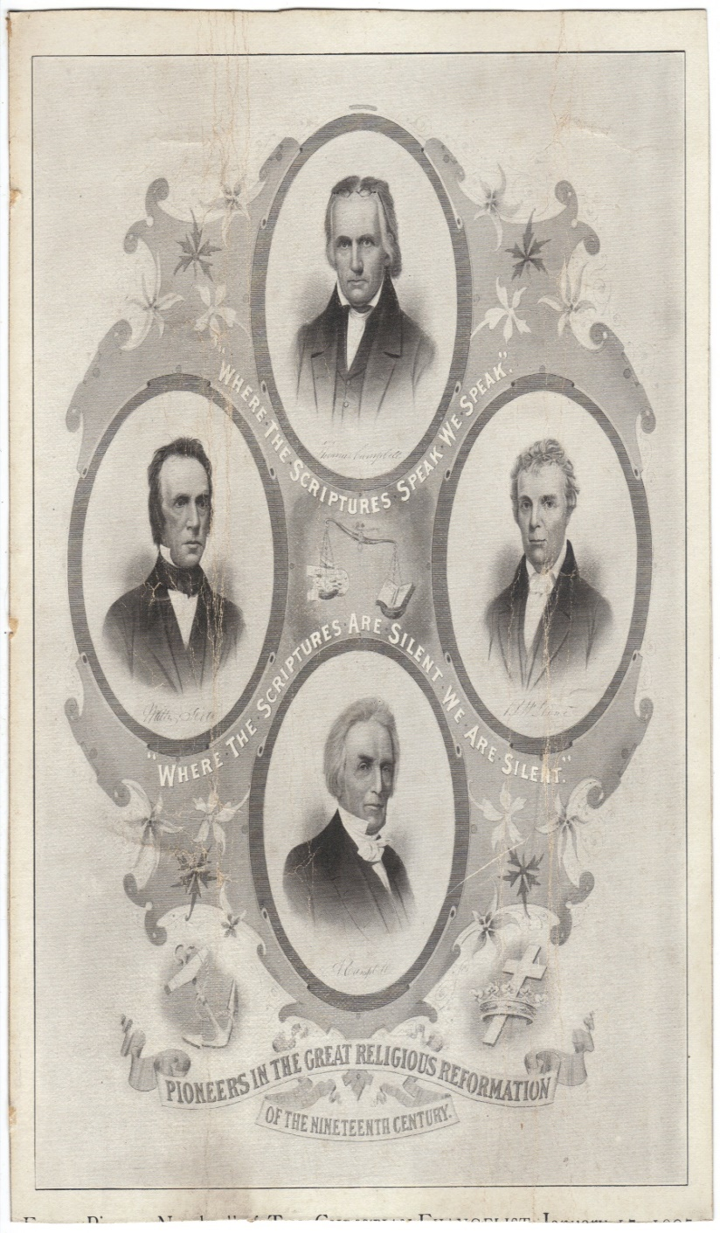
Stone-Campbell Restoration
The Merger
Jan 1, 1832, both groups agreed to restoring NT Christianity
Symbolized by a handshake between Stone and "Raccoon" John Smith representing the Disciples
The commitment to restoration included a plea for unity
Though both groups recognized their individual autonomy, they agreed to the same principle goal of restoration
Notes:
By 1832, both of the movements had become aware of the other and began communicating with each other. They decided to associate with one another in fellowship. While the Campbells were not present, they did send a representative of the movement in a man named “Raccoon” John Smith to the High Street Meeting House in Lexington, KY. Here, Barton Stone and “Raccoon” John Smith shook hands and made a mutual commitment to restore Christianity as only taught and practiced from the pages of the NT scriptures. This was not a meeting to create another denomination seeing as both groups recognized their individual autonomy. They merely agreed to the principal goal of restoration and nondenominationalism and agreed to help one another to the degree they could do so and continue to remain autonomous.

Slide 5
Theology Not Always Accurate
False Teachings
Briefly continued practicing infant baptism
Briefly continued fellowship with denominations
Argued against the Trinity
Argued against the purpose of Jesus’ death being for atonement
Premillennialists
Point: We dare not raise these men up on a shrine!
Notes:
While we are thankful for the work that these men did in restoring people to NT Christianity, we must be careful not to raise them up on a shrine for the mere reason that they are men. However, we also dare not do so because they had certain beliefs that were also not biblical. And if Barton Stone and Alexander Campbell were still alive today and wanted to place membership at this church teaching some of the things they did, we would take exception to that. “But didn’t your church of Christ arise from this movement?” No, this church exists because we too are wanting to practice nothing but biblical Christianity, to become the church that started in Acts 2, and to let the bible be our only standard of authority. We have no connection to these men seeing as we are almost 200 years removed from them and also given our own independence and autonomy. So what exactly were some of their struggling points?
First, even as the restoration movement was taking off, they continued accepting infant baptism for some time and continued fellowshipping with denominational churches with whom they shared sharp disagreements with, including the point at which a person becomes a Christian. While they eventually course corrected, it took quite a while for their practice to become consistent with biblical ideals.
Second, Stone rejected the classical view of the Trinity. He took a view that is called “subordinationism” that asserts that Jesus and the Holy Spirit are subordinate to God the Father in nature and being. In other words, they are not one as Jesus prayed they were in John 17:21-22. This view would put him at odds with those practicing true NT Christianity.
Third, Stone denied that Christ’s death was a substitutionary sacrifice and was more in line with Charles Finney’s view called the “moral influence theory”. This is the belief that the sole purpose and work of Christ’s sacrifice was to bring positive moral change to humanity, that the compelling nature of what He did would influence those who followed Him to want to live more moral lives. This, however, cannot be true or else his comparison to the lamb of the OT would make little sense.
Fourth, Campbell was a premillennialist, more specifically a “postmillennialist” who believed that a thousand year “golden age” will occur on the Earth before a return of Christ. He believed that the Kingdom of God would slowly expand upon the Earth until evil is defeated and Christianity reigns supreme. At that, point, he believed, Christ would return and a final judgment will occur. Unlike premillennialism, this postmillennialist view rejects a 7 year tribulation. Stone, on the other hand, was a classic premillennialist.

Slide 6
What Did They Stand For?
New Testament Pattern For The Church
Rom 6:17 – “But thanks be to God that though you were slaves of sin, you became obedient from the heart to that form (pattern) of teaching to which you were committed. ”
Phil 3:17 – “Brethren, join in following my example, and observe those who walk according to the pattern you have in us.”
2 Thes 3:9 – “not because we do not have the right to this, but in order to offer ourselves as a model for you, so that you would follow our example.”
2 Tim 1:13 – “Retain the standard of sound words which you have heard from me, in the faith and love which are in Christ Jesus.”

Slide 7
What Did They Stand For?
Plea for unity; reject denominationalism
John 17:20-23 – “²⁰I do not ask on behalf of these alone, but for those also who believe in Me through their word; ²¹that they may all be one; even as You, Father, are in Me and I in You, that they also may be in Us, so that the world may believe that You sent Me. ²²The glory which You have given Me I have given to them, that they may be one, just as We are one; ²³I in them and You in Me, that they may be perfected in unity, so that the world may know that You sent Me, and loved them, even as You have loved Me.”
1 Cor 1:10 – “Now I exhort you, brethren, by the name of our Lord Jesus Christ, that you all agree and that there be no divisions among you, but that you be made complete in the same mind and in the same judgment.”
1 Pet 3:8 – “To sum up, all of you be harmonious, sympathetic, brotherly, kindhearted, and humble in spirit.”
Eph 4:4-6 – “⁴There is one body and one Spirit, just as also you were called in one hope of your calling; ⁵one Lord, one faith, one baptism, ⁶one God and Father of all who is over all and through all and in all.”

Slide 8
What Did They Stand For?
Plea for unity; reject denominationalism
Martin Luther: “I ask that men make no reference to my name, and call themselves not Lutherans, but Christians. What is Luther? My doctrine, I am sure, is not mine, nor have I been crucified for any one. St. Paul, in 1 Cor. 3, would not allow Christians to call themselves Pauline or Petrine, but Christian. How then should I, poor, foul carcass that I am, come to have men give to the children of Christ a name derived from my worthless name? No, no, my dear friends; let us abolish all party names, and call ourselves Christians after Him Whose doctrine we have.” - Hugh Thomason Kerr, A Compend of Luther's Theology (Philadelphia: The Westminster Press, 1943, p. 135)
John Wesley: “Would to God that all party names, and unscriptural phrases and forms which have divided the Christian world, were forgot and that the very name [Methodist] might never be mentioned more, but be buried in eternal oblivion.” - John Wesley, Universal Knowledge, A Dictionary and Encyclopedia of Arts, Science, History, Biography, Law, Literature, Religions, Nations, Races, Customs, and Institutions, Vol. 9, Edward A. Pace, Editor (New York: Universal Knowledge Foundation, 1927, p. 540)
Charles Spurgeon: “I look forward with pleasure to the day when there will not be a Baptist living! I hope that the Baptist name will soon perish, but let Christ's name last forever.” - Spurgeon Memorial Library, Vol. I., p. 168

Slide 9
What Did They Stand For?
Renounce man-made names and creeds
Acts 11:26 – “And when he had found him, he brought him to Antioch. And for an entire year they met with the church and taught considerable numbers; and the disciples were first called Christians in Antioch.”
1 Cor 1:12 – “Now I mean this, that each one of you is saying, ‘I am of Paul,’ and ‘I of Apollos,’ and ‘I of Cephas,’ and ‘I of Christ.’”
2 Tim 3:16-17 – “¹⁶All Scripture is inspired by God and profitable for teaching, for reproof, for correction, for training in righteousness; ¹⁷so that the man of God may be adequate, equipped for every good work.”
2 Pet 1:3 – “Seeing that His divine power has granted to us everything pertaining to life and godliness, through the true knowledge of Him who called us by His own glory and excellence.”

